Slide 1
Impact of Imputation
On MRT 1 data

Slide 2
Imputation
Measures have been taken that each model can be trained on time series containing missing values:
Simple models leave out missing during fitting
EM Algorithm ignores missings during calculation of filter/smoother covariances, and hence the likelihood
PLRNN does not teacher force missings
Alternatively, one could forward impute missings

Slide 3
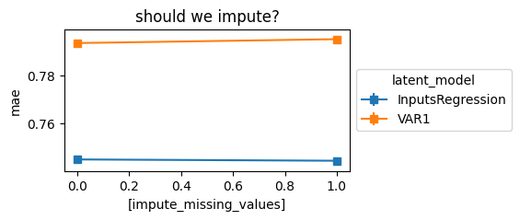
Testing impact of imputation
Almost no effect on MAE in Pregression, imputation slightly improves VAR

Slide 4
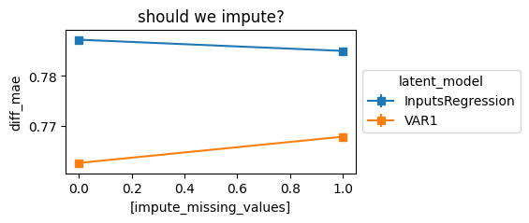
Testing impact of imputation
Imputation improves diff_MAE in VAR1, almost no effect on Regression

Slide 5
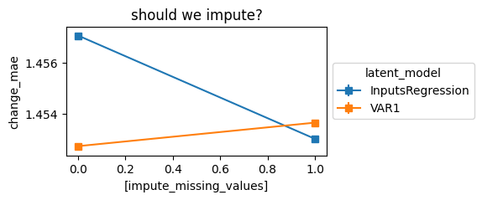
Testing impact of imputation
Very slight effects on change_MAE

Slide 6
Bottom line
Don‘t impute
There are small benefits for VAR, but not for Regression
The benefits don‘t outweigh the theoretical beauty of not having to care about missings

